Slide 1
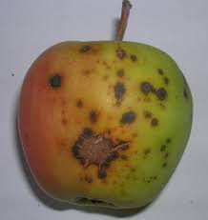



Artificial Neural Network
Blob Analysis
Feature Extraction
Learning
Input Image
Segmentation
Capture Image
Image Acquisition
Image Database
Learning
Pre-processing
Pre-processing
Feature Extraction
Classification
Comparision
Diagnosis

